Slide 1
24. JDBC
swli@cug.edu.cn
November 7, 2026
Notes:
本章一次课

Slide 2
Introduction to JDBC
made up of about two dozen Java classes in the package java.sql.
works in a similar way to Microsoft's database access library (known as ODBC )
works with Oracle, DB2 ,mySQL, ms SQL, xBase files, FoxPro, and MS Access. JDBC
JDBC can even access text files and Excel spreadsheets using the ODBC bridge

Slide 3
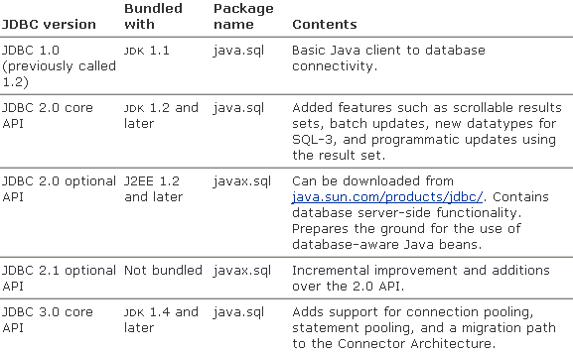
JDBC versions

Slide 4
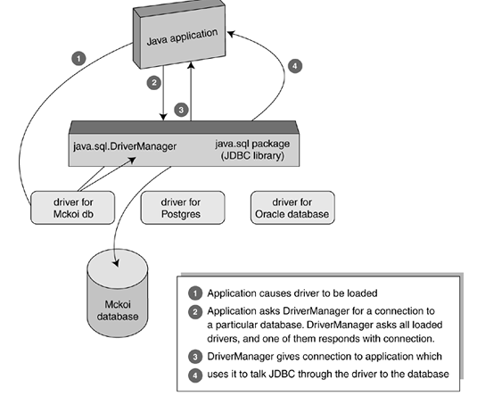
Connecting to the Database

Slide 5
Connecting to the Database
Load a JDBC driver
  Class.forName("com.mckoi.JDBCDriver");
Get a database connection
  String url = "jdbc:mckoi:local://ExampleDB.conf?create=true";
  connection = java.sql.DriverManager.getConnection(url, user, passwd);

Slide 6
Connect to Sql Server
Download
  sqljdbc.jar
Class.forName("com.microsoft.sqlserver.jdbc.SQLServerDriver").newInstance();
String url="jdbc:sqlserver://localhost; DatabaseName =dbname;";
  //sql server2000
  String url="jdbc:microsoft:sqlserver: //localhost;DatabaseName= dbname;";
Connection conn= DriverManager.getConnection( url,"sa","sa");
Notes:
Sql2005
Netbeans 需要： Copy sqljdbc.jar ->C:\Program Files\Java\jdk1.6.0_11\jre\lib\ext
命令行需要： -> C:\Program Files\Java\jre6\lib\ext

Slide 7
Executing SQL Statements
through a Statement object that we get from the connection object
  Statement myStmt = connection.createStatement();
  ResultSet myResult;
  myResult= myStmt.executeQuery( "SELECT * FROM Person;" );

Slide 8
Some methods of java.sql.Connection
Statement createStatement()
  Returns a statement object that is used to send SQL to the database.
PreparedStatement prepareStatement(String sql)
  Returns an object that can be used for sending parameterized SQL statements
CallableStatement prepareCall(String sql)
  Returns an object that can be used for calling stored procedures.
DataBaseMetaData getMetaData()
  Gets an object that supplies database configuration information
boolean isClosed()
  Reports whether the database is currently open or not.

Slide 9
methods of java.sql.Connection(more)
void setReadonly(boolean yn)
  Restores/removes read-only mode, allowing certain database optimizations
void commit()
  Makes all changes permanent since the previous commit/rollback
void rollback()
  Undoes and discards all changes done since the previous commit/rollback.
void setAutoCommit(boolean yn)
  Restores/removes auto-commit mode, which does an automatic commit after each statement

Slide 10
java.sql.statement methods for sql
SELECT
  executeQuery(String sql)
  return Result
INSERT, UPDATE, DELETE, CREATE, DROP
  executeUpdate(String sql)
  return int
Stored procedure with multiple results
  execute(String sql)
  return boolean
Close()

Slide 11
Result Sets(结果集)
columns are numbered starting with 1
  Statement stmt=conn.createStatement();//ResultSet.TYPE_SCROLL_SENSITIVE,ResultSet.CONCUR_UPDATABLE);
  ResultSet result = stmt.executeQuery( "select top 10 * from flow_users " );
  while (result.next()) {
  int a= result.getInt(1);
  String p = result.getString(2);
  System.out.println( p + "'s id " + a ); }
  demo
Notes:
import java.sql.*;
public class NewClass {
public static void main(String[] argv) throws ClassNotFoundException {
try {
String url = "jdbc:sqlserver://localhost;DatabaseName=Mapgisegov18;";
// String url="jdbc:microsoft:sqlserver://localhost;DatabaseName=Mapgisegov18;"; //sql server2000
Class.forName("com.microsoft.sqlserver.jdbc.SQLServerDriver").newInstance();
Connection conn = DriverManager.getConnection(url, "sa", "sa");
Statement stmt = conn.createStatement();//ResultSet.TYPE_SCROLL_SENSITIVE,ResultSet.CONCUR_UPDATABLE);
ResultSet result = stmt.executeQuery("select top 10 * from flow_users ");
while (result.next()) {
int a = result.getInt(1);
String p = result.getString(2);
System.out.println(p + "'s id is " + a);
}
} catch (Exception ex) {
ex.printStackTrace();
}
}
}

Slide 12
HSqlDb
pure Java database such
  McKoi (http://mckoi.com/database),
  HSQLDB (http://hsqldb.sourceforge.net)
    Only 1 jar
  Derby (http://incubator.apache.org/derby).
url
  jdbc:mckoi://localhost/ jdbc:postgresql:COREJAVA
  jdbc:hsqldb:mem:
  jdbc:hsqldb:hsql://localhost/

Slide 13
HSqlDb
Run database server
  java -cp ../lib/hsqldb.jar org.hsqldb.Server -database.0 file:mydb -dbname.0 xdb
Run database tools
  java -cp ../lib/hsqldb.jar org.hsqldb.util.DatabaseManager
  jdbc:hsqldb:hsql://localhost/xdb
Create table
  CREATE TABLE Greetings (Message CHAR(20)) INSERT INTO Greetings VALUES ('Hello, World!') SELECT * FROM Greetings

Slide 14
User HSQLDB
try {
Class.forName("org.hsqldb.jdbcDriver" ); } catch (Exception e) { System.out.println("ERROR: failed to load HSQLDB JDBC driver."); e.printStackTrace(); return; }
Connection c = DriverManager.getConnection("jdbc:hsqldb:hsql://localhost/xdb", "sa", "");
  DriverManager.getConnection(“jdbc:hsqldb:file:testdb”, “sa”, “”);//进程内
java -cp .;hsqldb.jar TestDB
demo
Notes:
/**
* Demonstrates how to use JDBC.
*/
import java.sql.*;
public class Main {
public static void main(String[] args) {
Connection connection;
try {
//DriverManager.getConnection("jdbc:odbc:Driver={MicroSoft Access Driver (*.mdb)};DBQ=C:/data/Access/test1.mdb","dba","sql");
//String url = "jdbc:odbc:Driver={MicroSoft Access Driver (*.mdb)};DBQ=D:\\2009java\\db1.mdb";
String url = "jdbc:hsqldb:hsql://localhost/xdb";
// String url="jdbc:microsoft:sqlserver://localhost;DatabaseName=Mapgisegov18;"; //sql server2000
// Class.forName("com.microsoft.sqlserver.jdbc.SQLServerDriver").newInstance();
Class.forName("org.hsqldb.jdbcDriver").newInstance();
connection = DriverManager.getConnection(url, "sa", "");
} catch (Exception e) {
e.printStackTrace();
return;
}
// --- Set up the database ---
try {
// Create a Statement object to execute the queries on,
Statement statement = connection.createStatement();
ResultSet result;
System.out.println("-- Creating Tables --");
statement.executeUpdate( " drop TABLE Person ");
// Create a Person table,
statement.executeUpdate(
" CREATE TABLE Person ( " +
" name VARCHAR(100) PRIMARY KEY, " +
" age INTEGER, " +
" lives_in VARCHAR(100) ) ");
System.out.println("-- Inserting Data --");
statement.addBatch("INSERT INTO Person ( name, age, lives_in ) VALUES " + " ( 'Robert Bellamy', 24, 'England' ); ");
statement.addBatch("INSERT INTO Person ( name, age, lives_in ) VALUES " + " ( 'Grayham Downer', null, 'Africa' );");
statement.addBatch(" INSERT INTO Person ( name, age, lives_in ) VALUES " + " ( 'Timothy French', 24, 'Africa' ); ");
statement.addBatch(" INSERT INTO Person ( name, age, lives_in ) VALUES " + " ( 'Butch Fad', 53, 'USA' ); ");
statement.addBatch(" INSERT INTO Person ( name, age, lives_in ) VALUES " + " ( 'Judith Brown', 34, 'Africa' ) ");
statement.executeBatch();
System.out.println("-- SQL queries --");
// get average age of the people
result = statement.executeQuery("SELECT AVG(age) FROM Person");
if (result.next()) {
System.out.println("Av. age: " + result.getDouble(1));
}
System.out.println();
// List the names of all the people that live in Africa
result = statement.executeQuery(
"SELECT name FROM Person WHERE lives_in = 'Africa' ");
System.out.println("All people that live in Africa:");
while (result.next()) {
System.out.println(" " + result.getString(1));
}
// Close the statement and the connection.
statement.close();
connection.close();
} catch (SQLException e) {
System.out.println(
"An SQLException occurred: " + e.getMessage());
} catch (Exception e) {
e.printStackTrace(System.err);
}
}
}

Slide 15
Pitfall: Reusing statements
  ResultSet result1, result2;
  result1 = myStmt.executeQuery( someSQLString );
  while (result1.next()) { /* more code */
  result2 = myStmt.executeQuery( someSQLString2 ); // NO! blows //away result1 }
Reusing the myStmt object will close the result1 result set
  Statement myOtherStmt = connection.createStatement();
  while (result1.next()) { /* more code... */
  result2 = myOtherStmt.executeQuery( someSQLString ); // OK. }
  demo
Notes:
import java.sql.*;
public class NewClass {
public static void main(String[] argv) throws ClassNotFoundException {
try {
String url = "jdbc:sqlserver://localhost;DatabaseName=Mapgisegov18;";
// String url="jdbc:microsoft:sqlserver://localhost;DatabaseName=Mapgisegov18;"; //sql server2000
Class.forName("com.microsoft.sqlserver.jdbc.SQLServerDriver").newInstance();
Connection conn = DriverManager.getConnection(url, "sa", "sa");
Statement stmt = conn.createStatement();//ResultSet.TYPE_SCROLL_SENSITIVE,ResultSet.CONCUR_UPDATABLE);
ResultSet result = stmt.executeQuery("select top 10 * from flow_users ");
while (result.next()) {
int a = result.getInt(1);
String p = result.getString(2);
System.out.println(p + "'s id is " + a);
stmt.execute("select top 1 * from flowCtrltbl");
}
} catch (Exception ex) {
ex.printStackTrace();

Slide 16
Cursor support (游标)
A default ResultSet object is not updatable and has a cursor that moves forward only
only go through the result records once
  Statement stmt = conn.createStatement( ResultSet.TYPE_SCROLL_INSENSITIVE, ResultSet.CONCUR_UPDATABLE );
Statement stmt = conn.createStatement( ResultSet.TYPE_SCROLL_INSENSITIVE, ResultSet.CONCUR_UPDATABLE );

Slide 17
More Cursor type
Be scrollable
  You can move backwards and forwards among the records of the result set
Not sense updates
  despite possible updates to the database from elsewhere, your result set will not change
Be updatable
  can call a method to change its value, and then another method to put that same change back in the database too

Slide 18
Batching SQL Statements
bundle a group of SQL statements in a batch
  Statement myStmt = conn.createStatement();
  myStmt.addBatch( myNonSelectSQL0 ); myStmt.addBatch( myNonSelectSQL1 ); myStmt.addBatch( myNonSelectSQL2 );
  int [] res = myStmt.executeBatch();

Slide 19
Transactions (事务)
Step:
  boolean savedCommitValue = conn.getAutoCommit();
  conn.setAutoCommit(false);
  int [] res = myStmt.executeBatch();
  conn.commit();
  conn.setAutoCommit(savedCommitValue);
issue a rollback
  conn.rollback();

Slide 20
Complete Example(sql server)
Make a connection with the database.
Create a Person table,
get average age of the people
List the names of all the people that live in Africa
Close the statement and the connection.
demo
Notes:
/**
* Demonstrates how to use JDBC.
*/
import java.sql.*;
public class NewClass {
public static void main(String[] args) {
Connection connection;
try {
String url = "jdbc:sqlserver://localhost;DatabaseName=Mapgisegov18;";
// String url="jdbc:microsoft:sqlserver://localhost;DatabaseName=Mapgisegov18;"; //sql server2000
Class.forName("com.microsoft.sqlserver.jdbc.SQLServerDriver").newInstance();
connection = DriverManager.getConnection(url, "sa", "sa");
} catch (Exception e) {
e.printStackTrace();
return;
}
// --- Set up the database ---
try {
// Create a Statement object to execute the queries on,
Statement statement = connection.createStatement();
ResultSet result;
System.out.println("-- Creating Tables --");
statement.executeUpdate(
" drop TABLE Person ");
// Create a Person table,
statement.executeUpdate(
" CREATE TABLE Person ( " +
" name VARCHAR(100) PRIMARY KEY, " +
" age INTEGER, " +
" lives_in VARCHAR(100) ) ");
System.out.println("-- Inserting Data --");
statement.executeUpdate(
" INSERT INTO Person ( name, age, lives_in ) VALUES " + " ( 'Robert Bellamy', 24, 'England' ); " + " INSERT INTO Person ( name, age, lives_in ) VALUES " + " ( 'Grayham Downer', null, 'Africa' );" + " INSERT INTO Person ( name, age, lives_in ) VALUES " + " ( 'Timothy French', 24, 'Africa' ); " + " INSERT INTO Person ( name, age, lives_in ) VALUES " + " ( 'Butch Fad', 53, 'USA' ); " + " INSERT INTO Person ( name, age, lives_in ) VALUES " + " ( 'Judith Brown', 34, 'Africa' ) ");
System.out.println("-- SQL queries --");
// get average age of the people
result = statement.executeQuery("SELECT AVG(age) FROM Person");
if (result.next()) {
System.out.println("Av. age: " + result.getDouble(1));
}
System.out.println();
// List the names of all the people that live in Africa
result = statement.executeQuery(
"SELECT name FROM Person WHERE lives_in = 'Africa' ");
System.out.println("All people that live in Africa:");
while (result.next()) {
System.out.println(" " + result.getString(1));
}
// Close the statement and the connection.
statement.close();
connection.close();
} catch (SQLException e) {
System.out.println(
"An SQLException occurred: " + e.getMessage());
} catch (Exception e) {
e.printStackTrace(System.err);
}
}
}

Slide 21
Complete Example(Access)
Url
  String url = "jdbc:odbc:Driver={MicroSoft Access Driver (*.mdb)};DBQ=D:\\2009java\\db1.mdb";
不需要
Class.forName("com.microsoft.sqlserver.jdbc.SQLServerDriver").newInstance();
statement.executeBatch();
  不支持多条语句用；分割
  demo
Notes:
/**
* Demonstrates how to use JDBC.
*/
import java.sql.*;
public class Main {
public static void main(String[] args) {
Connection connection;
try {
//DriverManager.getConnection("jdbc:odbc:Driver={MicroSoft Access Driver (*.mdb)};DBQ=C:/data/Access/test1.mdb","dba","sql");
//String url = "jdbc:odbc:Driver={MicroSoft Access Driver (*.mdb)};DBQ=D:\\2009java\\db1.mdb";
String url = "jdbc:hsqldb:hsql://localhost/xdb";
// String url="jdbc:microsoft:sqlserver://localhost;DatabaseName=Mapgisegov18;"; //sql server2000
// Class.forName("com.microsoft.sqlserver.jdbc.SQLServerDriver").newInstance();
Class.forName("org.hsqldb.jdbcDriver").newInstance();
connection = DriverManager.getConnection(url, "sa", "");
} catch (Exception e) {
e.printStackTrace();
return;
}
// --- Set up the database ---
try {
// Create a Statement object to execute the queries on,
Statement statement = connection.createStatement();
ResultSet result;
System.out.println("-- Creating Tables --");
statement.executeUpdate( " drop TABLE Person ");
// Create a Person table,
statement.executeUpdate(
" CREATE TABLE Person ( " +
" name VARCHAR(100) PRIMARY KEY, " +
" age INTEGER, " +
" lives_in VARCHAR(100) ) ");
System.out.println("-- Inserting Data --");
statement.addBatch("INSERT INTO Person ( name, age, lives_in ) VALUES " + " ( 'Robert Bellamy', 24, 'England' ); ");
statement.addBatch("INSERT INTO Person ( name, age, lives_in ) VALUES " + " ( 'Grayham Downer', null, 'Africa' );");
statement.addBatch(" INSERT INTO Person ( name, age, lives_in ) VALUES " + " ( 'Timothy French', 24, 'Africa' ); ");
statement.addBatch(" INSERT INTO Person ( name, age, lives_in ) VALUES " + " ( 'Butch Fad', 53, 'USA' ); ");
statement.addBatch(" INSERT INTO Person ( name, age, lives_in ) VALUES " + " ( 'Judith Brown', 34, 'Africa' ) ");
statement.executeBatch();
System.out.println("-- SQL queries --");
// get average age of the people
result = statement.executeQuery("SELECT AVG(age) FROM Person");
if (result.next()) {
System.out.println("Av. age: " + result.getDouble(1));
}
System.out.println();
// List the names of all the people that live in Africa
result = statement.executeQuery(
"SELECT name FROM Person WHERE lives_in = 'Africa' ");
System.out.println("All people that live in Africa:");
while (result.next()) {
System.out.println(" " + result.getString(1));
}
// Close the statement and the connection.
statement.close();
connection.close();
} catch (SQLException e) {
System.out.println(
"An SQLException occurred: " + e.getMessage());
} catch (Exception e) {
e.printStackTrace(System.err);
}
}
}

Slide 22
program with database
  String userName=“abc”
  int userId=123;
Insert
  String strSql=“Insert into users(name,id) values(‘”+userName”+”’,’”+userId+”’)”;
  Stmt.execute(str)
Delete
Update
select

Slide 23
MySQL
下载mysql-5.6.xx.xx.zip文件
  解压
启动服务器
  运行 mysqld.exe,数据库服务已经启动
运行命令行客户端
  运行目录下的 mysql.exe

Slide 24
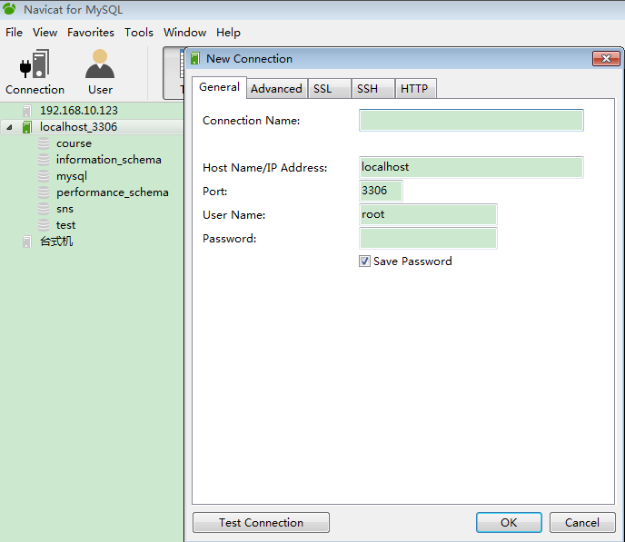

Navicat for MySQL

Slide 25
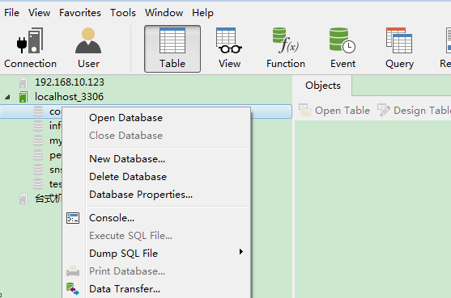
Navicat for MySQL

Slide 26
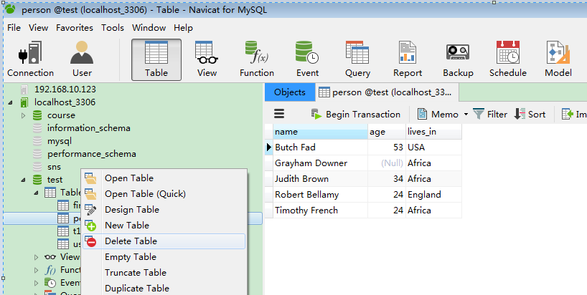
Navicat for MySQL

Slide 27
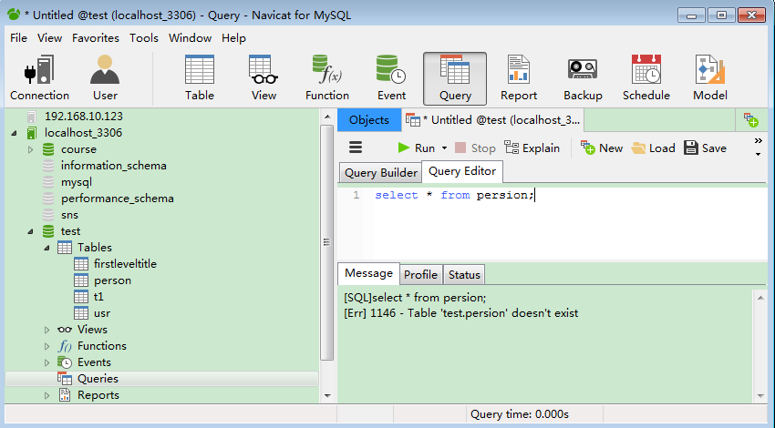
Navicat for MySQL

Slide 28
MySql命令
登录服务器
  mysql.exe -u root
显示数据库
  Show databases;
  Show schemas;
创建数据库
  Create database dbname;
  Create schema dbname;
其他SQL
  Create table
  Create view
Notes:
CREATE TABLE Person (name VARCHAR(100) PRIMARY KEY,age INTEGER lives_in VARCHAR(100) )
INSERT INTO Person ( name, age, lives_in ) VALUES ( 'Robert Bellamy', 24, 'England' );
INSERT INTO Person ( name, age, lives_in ) VALUES ( 'Grayham Downer', null, 'Africa' );
INSERT INTO Person ( name, age, lives_in ) VALUES ( 'Timothy French', 24, 'Africa' );
INSERT INTO Person ( name, age, lives_in ) VALUES ( 'Butch Fad', 53, 'USA' );
INSERT INTO Person ( name, age, lives_in ) VALUES ( 'Judith Brown', 34, 'Africa' )

Slide 29
MySql
In Java
  Class.forName("com.mysql.jdbc.Driver");
  Connection connect = DriverManager.getConnection( "jdbc:mysql://localhost:3306/test","root",“”);

Slide 30
Prepared statements (参数化查询)
Why?
  ‘ – 二进制数据
  性能
Example:
  PreparedStatement pstmt = conn.prepareStatement( "UPDATE EMPLOYEES SET SALARY = ? WHERE ID = ?");
  pstmt.setBigDecimal(1, 150000.00);
  pstmt.setInt(2, linden4303);
  pstmt.executeUpdate();
PreparedStatement has its own versions
  executeQuery(), executeUpdate(), and execute().

Slide 31
Stored procedures (存储过程)
Create Procedure
  You can create them using SQL commands to install and manage stored procedures, and submit these commands using executeUpdate() in the normal way.
  You can write the stored procedure following the SQLJ conventions. SQLJ is an industry standard covering how to embed SQL statements into Java methods and how to use Java methods for stored procedures

Slide 32
Stored procedures example
statement.executeUpdate( " CREATE procedure avg_age as Begin SELECT AVG(age) as avgage FROM Person END; ");
CallableStatement cs=connection.prepareCall("avg_age");
ResultSet result = cs.executeQuery();
demo
Notes:
/**
* Demonstrates how to use JDBC.
*/
import java.sql.*;
public class Newclass {
public static void main(String[] args) {
Connection connection;
try {
//DriverManager.getConnection("jdbc:odbc:Driver={MicroSoft Access Driver (*.mdb)};DBQ=C:/data/Access/test1.mdb","dba","sql");
//String url = "jdbc:odbc:Driver={MicroSoft Access Driver (*.mdb)};DBQ=D:\\2009java\\db1.mdb";
// String url = "jdbc:hsqldb:hsql://localhost/xdb";
// // String url="jdbc:microsoft:sqlserver://localhost;DatabaseName=Mapgisegov18;"; //sql server2000
// // Class.forName("com.microsoft.sqlserver.jdbc.SQLServerDriver").newInstance();
// Class.forName("org.hsqldb.jdbcDriver").newInstance();
Class.forName("com.mysql.jdbc.Driver");
connection = DriverManager.getConnection("jdbc:mysql://localhost:3306/test","root","");
// connection = DriverManager.getConnection(url, "sa", "");
} catch (Exception e) {
e.printStackTrace();
return;
}
// --- Set up the database ---
try {
// Create a Statement object to execute the queries on,
Statement statement = connection.createStatement();
ResultSet result;
System.out.println("-- Creating Tables --");
statement.executeUpdate( " drop TABLE Person ");
// Create a Person table,
statement.executeUpdate(
" CREATE TABLE Person ( " +
" name VARCHAR(100) PRIMARY KEY, " +
" age INTEGER, " +
" lives_in VARCHAR(100) ) ");
System.out.println("-- Inserting Data --");
statement.addBatch("INSERT INTO Person ( name, age, lives_in ) VALUES " + " ( 'Robert Bellamy', 24, 'England' ); ");
statement.addBatch("INSERT INTO Person ( name, age, lives_in ) VALUES " + " ( 'Grayham Downer', null, 'Africa' );");
statement.addBatch(" INSERT INTO Person ( name, age, lives_in ) VALUES " + " ( 'Timothy French', 24, 'Africa' ); ");
statement.addBatch(" INSERT INTO Person ( name, age, lives_in ) VALUES " + " ( 'Butch Fad', 53, 'USA' ); ");
statement.addBatch(" INSERT INTO Person ( name, age, lives_in ) VALUES " + " ( 'Judith Brown', 34, 'Africa' ) ");
statement.executeBatch();
System.out.println("-- SQL queries --");
// get average age of the people
result = statement.executeQuery("SELECT AVG(age) FROM Person");
if (result.next()) {
System.out.println("Av. age: " + result.getDouble(1));
}
System.out.println();
// List the names of all the people that live in Africa
result = statement.executeQuery(
"SELECT name FROM Person WHERE lives_in = 'Africa' ");
System.out.println("All people that live in Africa:");
while (result.next()) {
System.out.println(" " + result.getString(1));
}
System.out.println("-- Creating store procedure--");
statement.executeUpdate(" drop PROCEDURE avg_age");
// Create a Person table,
// statement.executeUpdate("DELIMITER //");
statement.executeUpdate(
" CREATE PROCEDURE avg_age() \n"
+ " Begin \n"
+ "SELECT AVG(age) FROM Person;\n"
+ " END;");
// statement.executeUpdate( " DELIMITER ;");
CallableStatement cs=connection.prepareCall("call avg_age()");
//sql server CallableStatement cs=connection.prepareCall("avg_age()");
// List the names of all the people that live in Africa
result = cs.executeQuery();
if (result.next()) {
System.out.println("Av. age: " + result.getDouble(1));
}
// Close the statement and the connection.
statement.close();
connection.close();
} catch (SQLException e) {
System.out.println(
"An SQLException occurred: " + e.getMessage());
} catch (Exception e) {
e.printStackTrace(System.err);
}
}
}

Slide 33
Database Metadata(元数据)
  ResultSet result = statement.executeQuery( "SELECT c1, c2 FROM myTable; “
  ResultSetMetaData rsmd = result.getMetaData();
find out how many columns the result has
  int numberCols = rsmd.getColumnCount();
to learn whether the first column in the result set can be used in a WHERE clause
  boolean b = rsmd.isSearchable(1);

